Slide 1
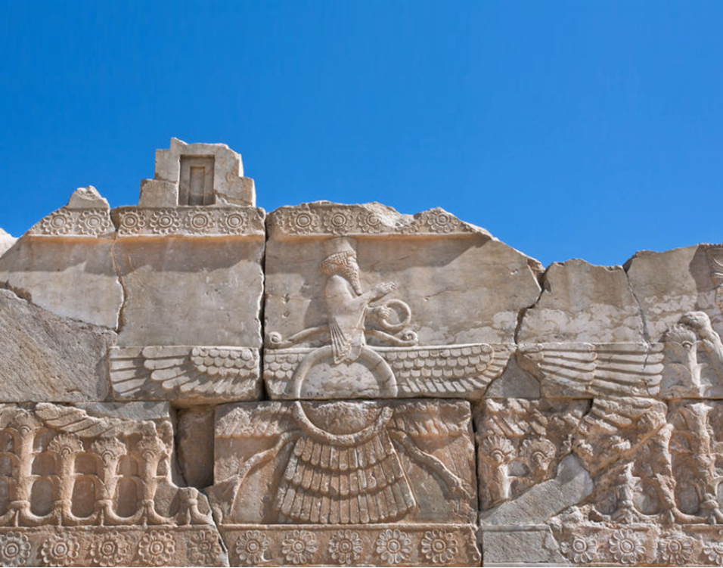
Achaemenid Empire
Doruk Çetin

Slide 2
Who were the Achaemenids?
Cyrus and Pasargadae
Darius and Persepolis
Greco-Persian Wars
Zoroastrianism
End of the Empire

Slide 4
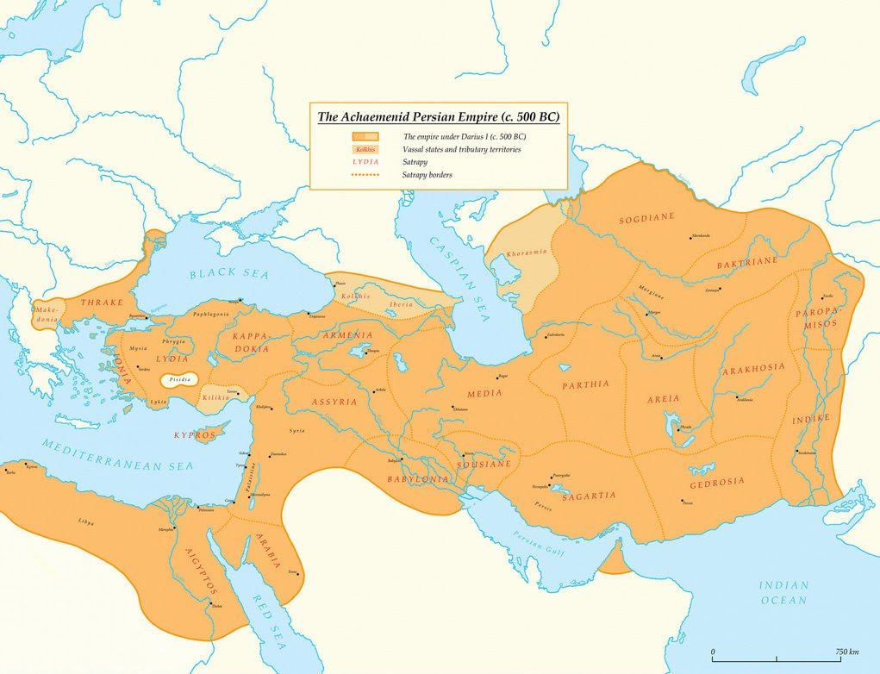
Median Empire
Achaemenid Empire
Seleucid Empire
Parthian Empire
Sasanian Empire
…
550 BC – 330 BC
Media
Persis

Slide 5
Cyrus the Great
Cyrus the Great
His standard

Slide 6
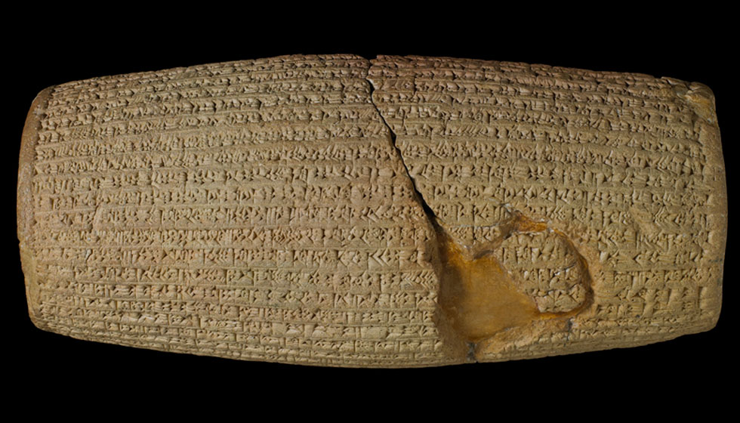
Cyrus Cylinder

Slide 7
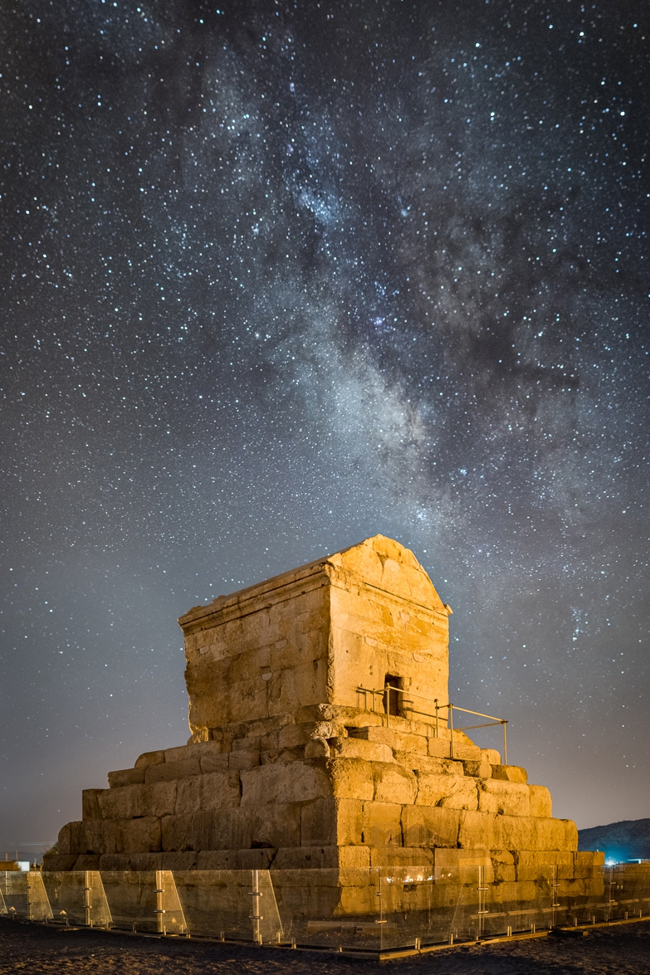
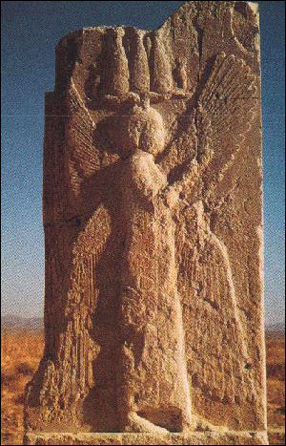
Pasargadae
Tomb of Cyrus – on left
Bas-relief of Cyrus – on top

Slide 8
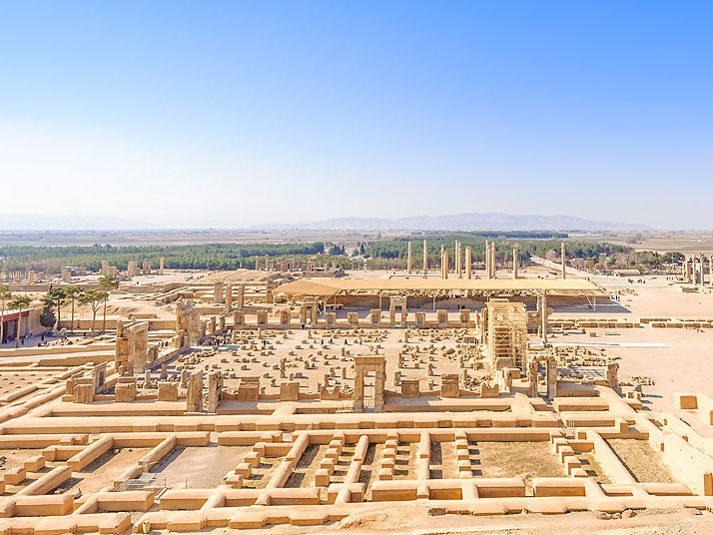
Persepolis

Slide 9
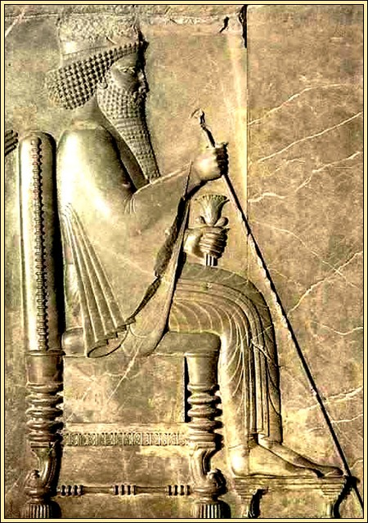
Darius the Great

Slide 10
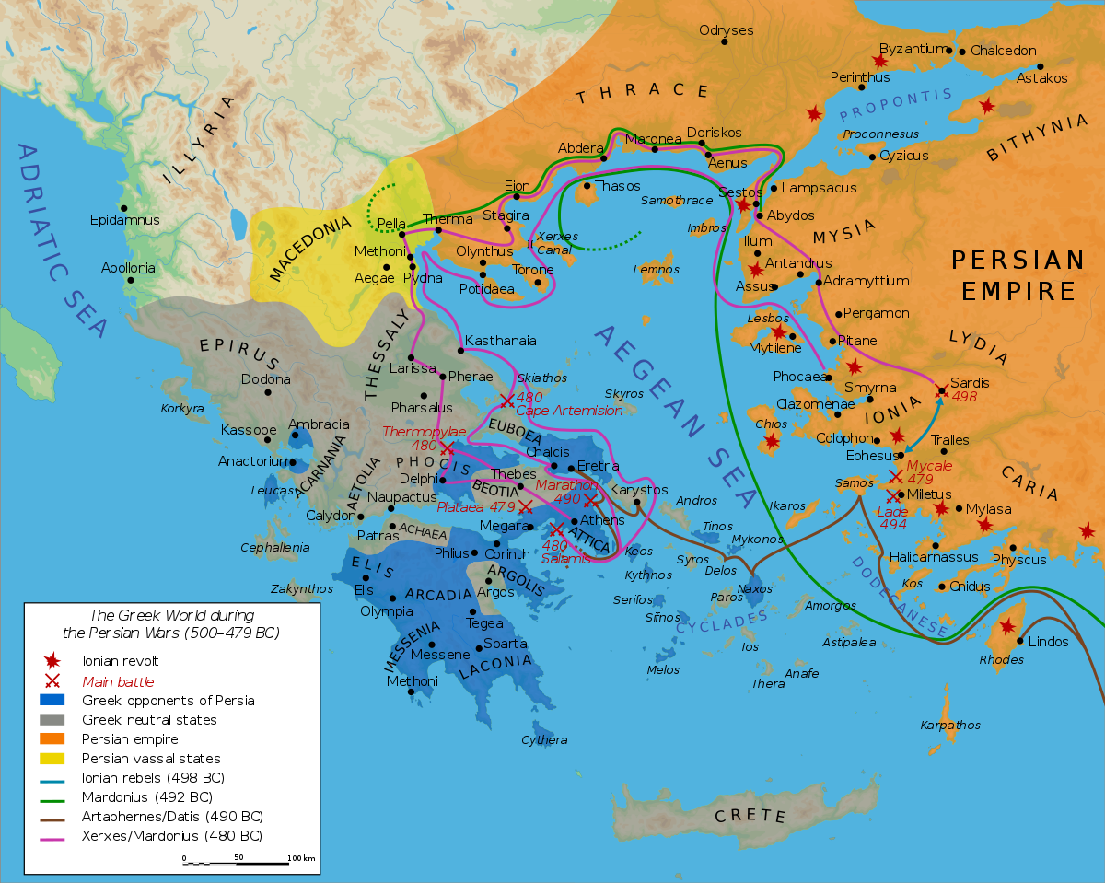
Greco-Persian Wars

Slide 11
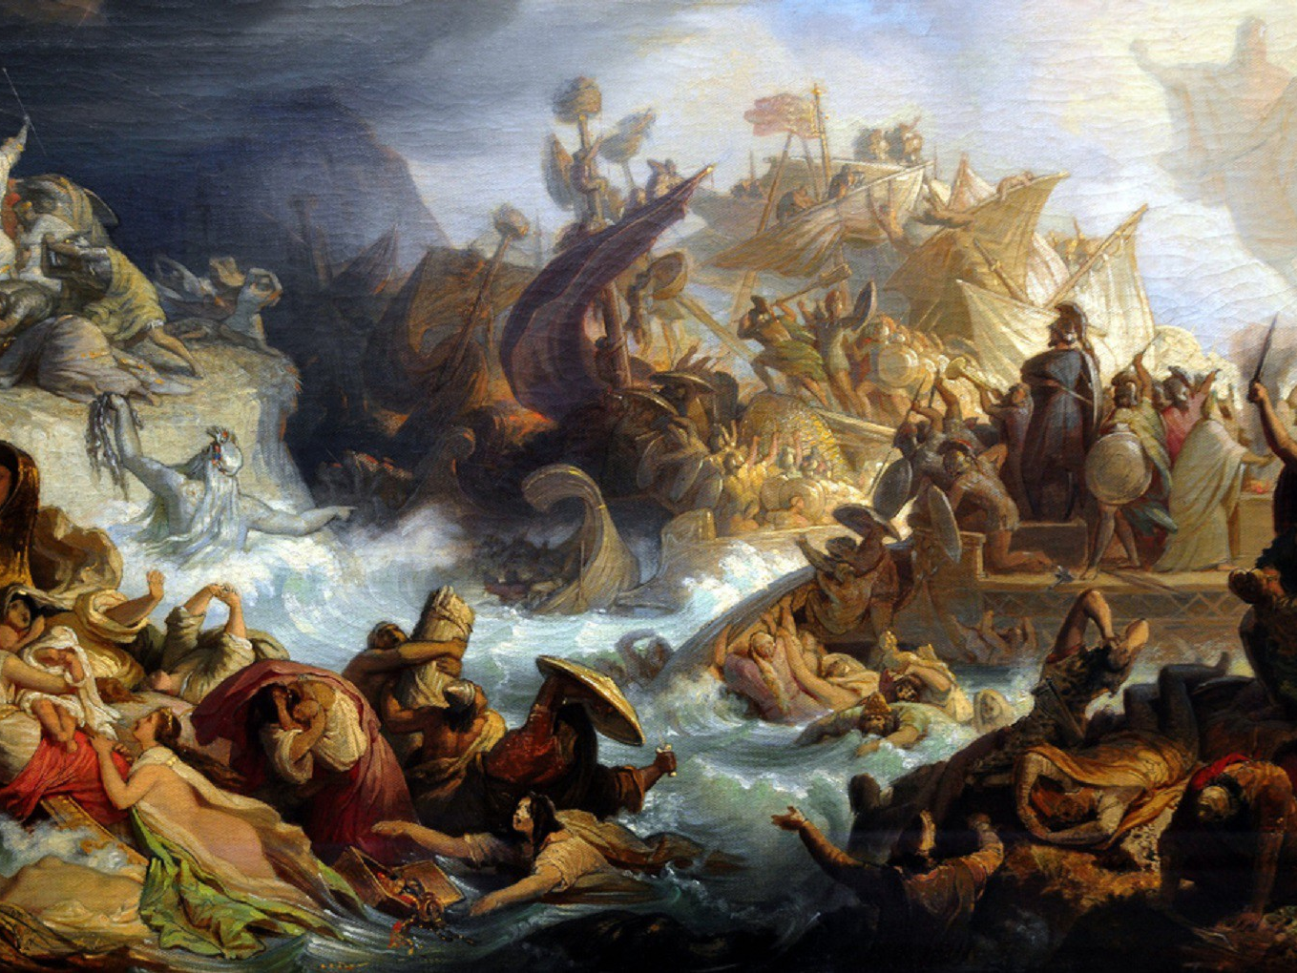
Greco-Persian Wars
Battle of Marathon
Battle of Thermopylae
Battle of Salamis
Battle of Plataea
- "Because of the arrows of the barbarians it is impossible to see the sun"
+ "Won't it be nice, then, if we shall have shade in which to fight them?"

Slide 12
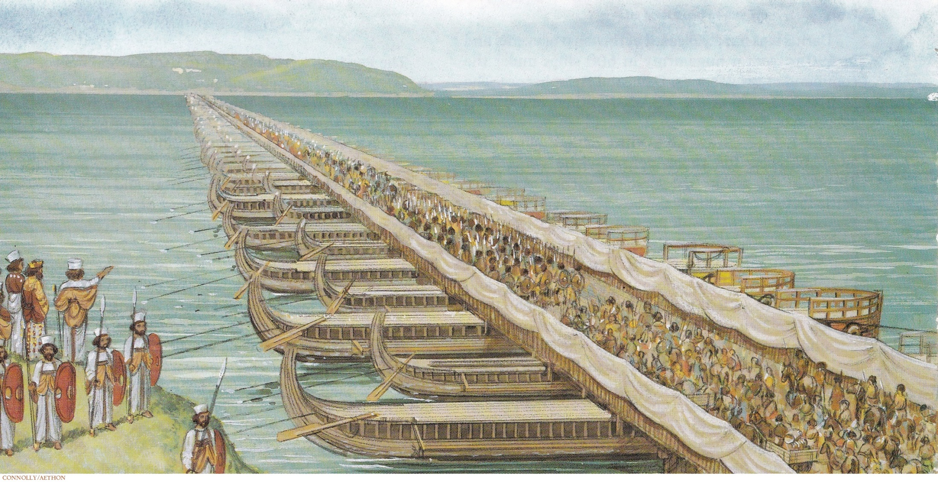
Bridge over Dardanelles

Slide 13
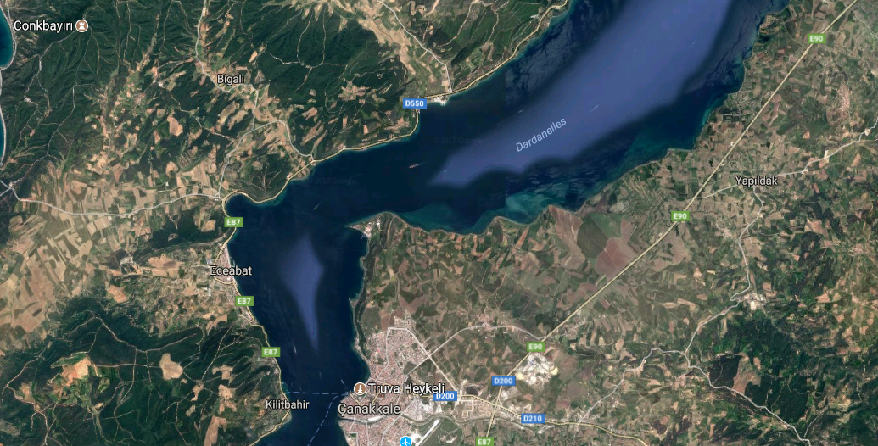
Çanakkale Today
Sestos
Abydos

Slide 14
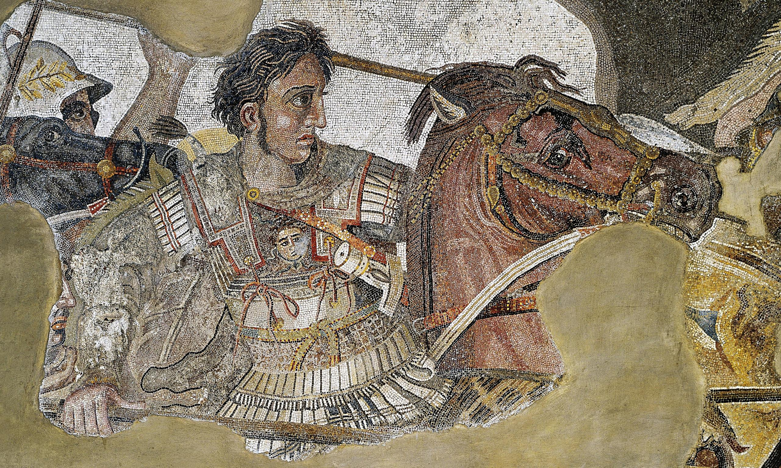
Alexander the Great

Slide 15
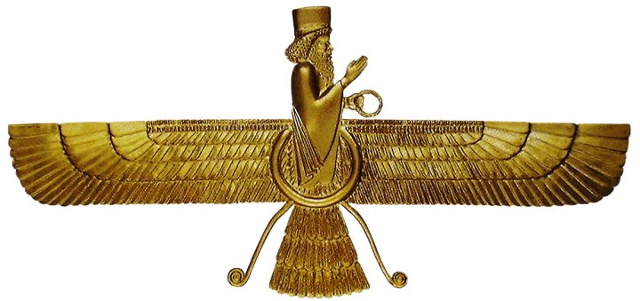
Zoroastrianism
Faravahar

Slide 16
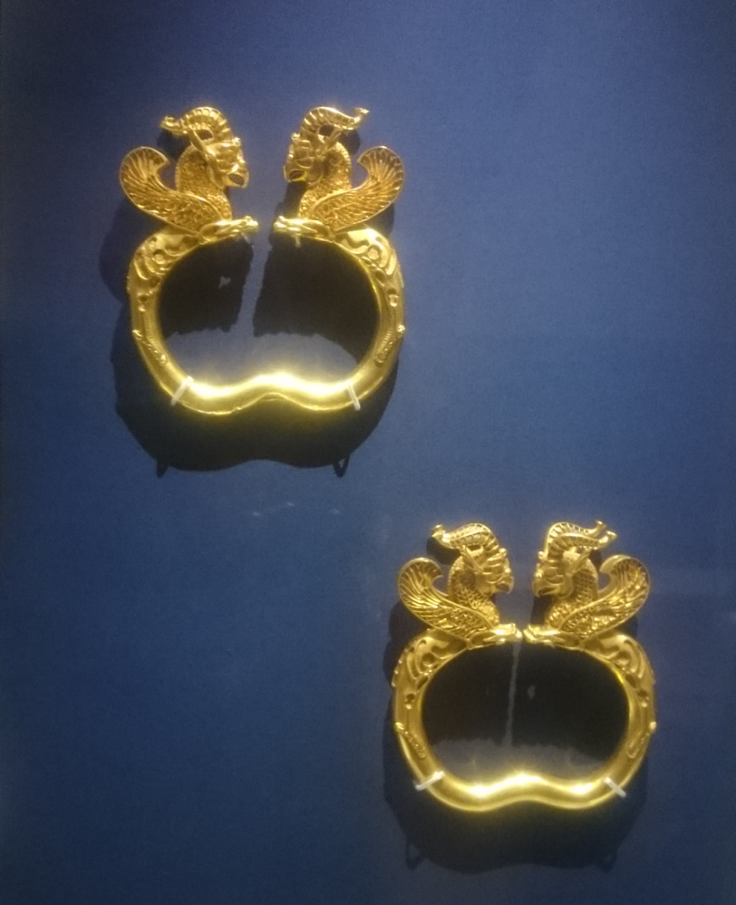
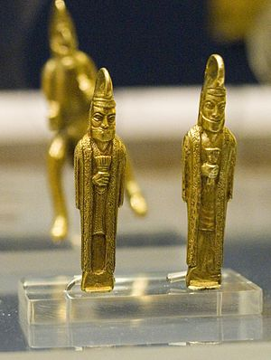
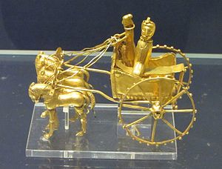
Oxus Treasure
Questions?

Slide 17
References
Beginnings of the Athenian Empire: 9.114-122, http://www.thelatinlibrary.com/historians/herod/herodotus13.html
Martin, Thomas R., (2013) Ancient Greece From Prehistoric to Hellenistic Times, Second Edition, Yale University Press
Briant, Pierre (2002) From Cyrus to Alexander: a history of the Persian Empire, Winnona Lake, IN: Eisenbraun
Ivantchik, A., Licheli, V. (2007) Achaemenid culture and local traditions in Anatolia, Southern Caucasus and Iran : new discoveries, Leiden: Brill
Plutarch, Moralia p243, Sayings of Spartans, http://penelope.uchicago.edu/Thayer/E/Roman/Texts/Plutarch/Moralia/Sayings_of_Spartans*/main.html

Slide 18
Photo Sources
1st slide, Persepolis: Pinterest
2nd slide, Persepolis: Wikimedia Commons
3rd slide, Hugging vs Invading Persia: Reddit
4th slide, Map of the Persian Empire: Quora
5th slide, Cyrus the Great: Iran Chamber Society
5th slide, Standard of Cyrus: Wikimedia Commons
6th slide, Cyrus Cylinder: Cyrus Cylinder US Tour 2013
7th slide, Tomb of Cyrus: Wikimedia Commons
7th slide, Bas-relief of Cyrus: Iran Chamber Society
8th slide, Persepolis: Telegraph
9th slide, Darius the Great: My Science School
10th slide, Map of the Greco-Persian Wars: Wikimedia Commons
11th slide, Battle of Salamis: Wikimedia Commons
12th slide, Bridge over Dardanelles: Pinterest
13th slide, Satellite view of Çanakkale: Google Earth
14th slide, Alexander the Great Mosaic: Wikimedia Commons
15th slide, Faravahar: Medium.com
16th slide, Oxus Treasure: Wikimedia Commons
16th slide, Oxus Treasure: Wikimedia Commons
16th slide, Oxus Treasure: Myself

